Slide 1



Eclipse SDV Hackathon Chapter 4
OTA Outlaws: Safety Evidence Factory
Doctor Whodunit · Every fault leaves evidence
October 6-8 2026
COPYRIGHT (C) 2026, ECLIPSE FOUNDATION
Notes:
Hi, we are the OTA Outlaws. In the Doctor Whodunit challenge we built a Safety Evidence Factory: it injects faults into a safety function and proves - automatically and traceably - that the fault was caught.

Slide 2




The Problem: A Stuck Sensor Silences the Warning
≥ 5 min
UN R100 warning time
Sensor
Monitor
Occupants
Stuck at 42 °C
“All clear”
No warning
Every OTA
UN R156 proof per update
How do you prove the warning still works – on every OTA release?
07/2026
GB 38031: no fire, no explosion
Copyright© Eclipse Foundation AISBL and contributors. Made available under CC-BY-SA 4.0 International.
Notes:
If a cell-temperature signal freezes, the safety monitor sees a stable value and stays silent - exactly when it should warn. Regulation is tightening: UN R100.03 / GTR 20 require an occupant warning at least 5 minutes before a thermal event becomes hazardous; UN R156 requires a managed, documented process for every software update (mandatory for new EU vehicles since July 2024); China's GB 38031-2025 demands no fire and no explosion from July 2026. Today, proving that monitors still work is manual HIL lab work, repeated per release.

Slide 3



Our Solution: A Portable Safety Evidence Factory
Hazard
Safety goal
Fault
Detection
Mitigation
Verdict
Every verdict traced back to its hazard – automatically.
Traceable
Portable
Repeatable
Hazard → verdict, every test
CI · Cloud · Vehicle
Same input, same verdict
Copyright© Eclipse Foundation AISBL and contributors. Made available under CC-BY-SA 4.0 International.
Notes:
Our answer is a Safety Evidence Factory. It starts from the HARA: six hazardous events (HE-1..6), four safety goals (SG-1..4). For each requirement we inject faults - 19 scenarios today - observe detection by the Guardian and the DTC, the mitigation request over uProtocol, read the diagnostics from OpenSOVD and produce a PASS / FAIL / INCONCLUSIVE verdict. Traceable: hazard to verdict for every test. Portable: same campaigns in CI, cloud and vehicle, built on KUKSA, uProtocol and OpenSOVD. Repeatable: deterministic replays with measured timing; failures are reported, never hidden.

Slide 4
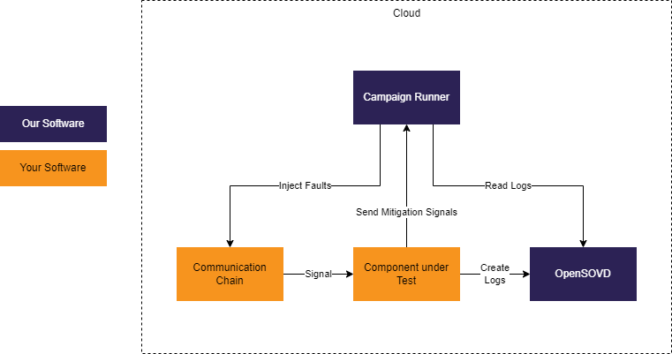
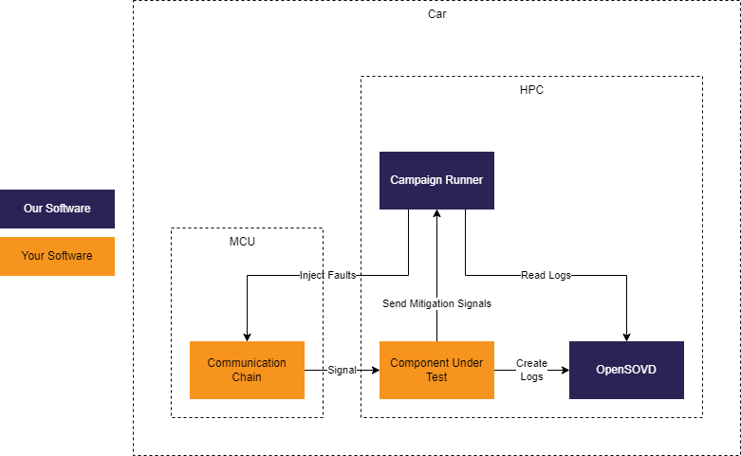
Product: Cloud and In-Vehicle
1
Cloud / CI
2
In-Vehicle (HPC + MCU)
Evidence on every release – no lab
Same campaigns – evidence from the road
Our software
Your software
Copyright© Eclipse Foundation AISBL and contributors. Made available under CC-BY-SA 4.0 International.
Notes:
Two products, one campaign format. 1) Cloud / CI: the customer brings the communication chain and the component under test, we bring the campaign runner and OpenSOVD-based evidence collection - evidence on every commit and release without lab time, for OEM and Tier-1 software and safety teams. 2) In-vehicle: the same campaign runner on the vehicle HPC (AutoSD, Ankaios), injecting faults at the MCU boundary - for validation fleets, prototypes and the field.

Slide 5

Live Demo: Catching a Stuck Sensor
1
2
3
4
5
Baseline
Inject
Detect
Diagnose
Verdict
Sensor → Guardian
Freeze temperature
Warning requested
DTC in OpenSOVD
PASS, traced to HE-1
Measured, not claimed: detection · mitigation · diagnostics ≤ 2 s
Copyright© Eclipse Foundation AISBL and contributors. Made available under CC-BY-SA 4.0 International.
Notes:
Live demo (about 90 seconds): 1) baseline from the AZ3166 board through KUKSA CAN Provider, Data Broker and uProtocol into the Guardian; 2) the campaign runner freezes the cell temperature (temp_stuck); 3) the Guardian raises BTG_TempSignalStuck, goes degraded and requests a driver warning; 4) the DTC with session and event ID shows up in OpenSOVD; 5) the report links it to FSR-2.4, SG-2 and HE-1: PASS. Detection latency, mitigation timing and diagnostic visibility (2 s budget) are measured on every run. Fallback if live fails: show the campaign report PDF. Optional one-liner: in the hackathon our full 19-scenario campaign found 5 real bugs in our own Guardian - and reported them.

Slide 6
Competition: We Connect What Others Keep Separate
Fault injection
Traceability
CI / Cloud
In vehicle
Open source
HIL test tools
Vector · dSPACE · tracetronic
Safety / ALM tools
medini · Polarion · Codebeamer
OTA Outlaws
strong
partial
none
Team assessment
We complement HIL and ALM tools – not replace them.
Copyright© Eclipse Foundation AISBL and contributors. Made available under CC-BY-SA 4.0 International.
Notes:
HIL vendors (Vector, dSPACE, tracetronic) are strong at fault injection but lab-bound and proprietary. Safety and ALM tools (Ansys medini, Siemens Polarion, PTC Codebeamer) hold the traceability but no live test evidence. We close the gap and feed both with live, traceable evidence. The matrix is our team's assessment of public product positioning.

Slide 7
The Market: Regulation Makes Evidence Mandatory
$9.1 bn
20 M+
100 %
SW testing market 2025
EVs sold in 2025
new EU cars under UN R156
MarketsandMarkets
IEA
since 07/2024
START
NEXT
VISION
Battery safety
SDV safety monitors
Evidence-as-a-Service
Copyright© Eclipse Foundation AISBL and contributors. Made available under CC-BY-SA 4.0 International.
Notes:
Automotive software testing alone is a 9.1 billion dollar market (MarketsandMarkets 2025). More than 20 million EVs were sold in 2025 - one in four new cars (IEA) - and every one needs battery safety evidence. UN R156 makes a certified software update process mandatory for new EU vehicles since July 2024. We start where the pain is sharpest - battery and thermal safety, ASIL-D hazards with frequent OTA updates - then expand to other SDV safety monitors (sensor plausibility, ADAS input monitoring, watchdogs), and finally evidence-as-a-service for any safety-relevant SDV service.

Slide 8


Business Case: Who Pays and What They Save
OEMs & Tier-1s
Evidence Cloud · from €2.5k / month
Fleets
In-vehicle agent · per-vehicle licence
Every new safety function
Onboarding · €40k
−66 %
payback ≈ 6 months
Open-source core: free entry
Illustrative: 12 OTA releases / year, from year 2
Copyright© Eclipse Foundation AISBL and contributors. Made available under CC-BY-SA 4.0 International.
Notes:
Who pays: OEMs and Tier-1 BMS suppliers subscribe to the Evidence Cloud (from about 2.5k euros per project per month) - an evidence package for every OTA release and every software drop (UN R156, ISO 26262). Fleet operators license the in-vehicle agent per vehicle for periodic self-tests in the field. Every new safety function starts with a fixed-price onboarding of about 40k euros (HARA, safety concept, campaign setup). The open-source core is the free entry point in the Eclipse SDV ecosystem. What they save, for one safety function with 12 OTA releases a year: manual regression costs about 125k euros per year (8 engineer days plus 3 HIL bench days per release); with the factory it is 42k from year two - two thirds less, payback in about six months. All numbers are illustrative and will be validated in pilots.

Slide 9
Roadmap and Funding Ask
1
Q4 2026
2
2027
3
2028
Harden
Pilot
Scale
Remote reruns · AutoSD
2 paid pilots · Blueprint
Tool qualification · SaaS
€1.2 M seed
60 %
15 %
15 %
10 %
18 months runway
Engineering
Qualification
Pilots & sales
Infrastructure
Copyright© Eclipse Foundation AISBL and contributors. Made available under CC-BY-SA 4.0 International.
Notes:
Phase 1 (Q4 2026 - Q1 2027) Harden: remote reruns via openDuT, Ankaios / AutoSD orchestration, durable DFM storage, fix the open findings. Phase 2 (2027) Pilot: two paid pilots with an OEM and a Tier-1, publish as SDV Blueprint, first managed cloud runners. Phase 3 (Q4 2027 - 2028) Scale: ISO 26262 tool qualification, SaaS general availability, beyond BMS to ADAS monitors. We ask for 1.2 million euros seed for 18 months: 720k engineering (5 FTE), 180k tool qualification and certification, 180k pilots and go-to-market, 120k cloud infrastructure and hardware.

Slide 10

Team and Contact
J
Jens
S
Sopan
Y
Youssef
Lead & Safety
CAN & ThreadX
KUKSA
A
Anukul
J
Jannis
J
Julian
OpenSOVD & AutoSD
Guardian
uProtocol & Dashboard
github.com/Eclipse-SDV-Hackathon-Chapter-Four/ota-outlaws
Looking for: pilot partners
Copyright© Eclipse Foundation AISBL and contributors. Made available under CC-BY-SA 4.0 International.
Notes:
Six people, one evidence chain - from the sensor ECU to the safety case. Jens: project lead, requirements and safety engineering. Sopan: CAN and the ThreadX sensor ECU (AZ3166). Youssef: KUKSA CAN Provider and Data Broker. Anukul: OpenSOVD, AutoSD, openDuT. Jannis: Battery Thermal Guardian. Julian: uProtocol, watchdog and dashboard. Everything is open source (EPL-2.0) on GitHub. We are looking for pilot partners (OEM / Tier-1), safety assessors and contributors.

Slide 11
Thank you!
Questions?
Every fault leaves evidence.
October 6-8 2026
COPYRIGHT (C) 2026, ECLIPSE FOUNDATION
Notes:
Thank you - happy to take questions.

